Slide 1
Network Layer
Routing Algorithms
The Optimality Principle
Dijkstras Algorithm

Slide 2
Network Layer
Routing Algorithms
The main function of the network layer is routing packets from the source machine to the destination machine. In most subnets, packets will require multiple hops to make the journey.
The only notable exception is for broadcast networks, but even here routing is an issue if the source and destination are not on the same network.
The routing algorithm is that part of the network layer software responsible for deciding which output line an incoming packet should be transmitted on. If the subnet uses datagrams internally, this decision must be made anew for every arriving data packet since the best route may have changed since last time. If the subnet uses virtual circuits internally, routing decisions are made only when a new virtual circuit is being set up. Thereafter, data packets just follow the previously-established route. The latter case is sometimes called session routing because a route remains in force for an entire user session

Slide 3
Network Layer
It is sometimes useful to make a distinction between routing, which is making the decision which routes to use, and forwarding, which is what happens when a packet arrives. One can think of a router as having two processes inside it. One of them handles each packet as it arrives, looking up the outgoing line to use for it in the routing tables. This process is forwarding.
The other process is responsible for filling in and updating the routing tables.
It is done by Routing Algorithms

Slide 4
Network Layer
Properties routing algorithm: correctness, simplicity, robustness, stability, fairness, and optimality.
The routing algorithm should be able to cope with changes in the topology and traffic without requiring all jobs in all hosts to be aborted and the network to be rebooted every time some router crashes.
Routing algorithms can be grouped into two major classes: nonadaptive and adaptive.

Slide 5
Network Layer
Nonadaptive algorithms do not base their routing decisions on measurements or estimates of the current traffic and topology. Instead, the choice of the route to use to get from I to J (for all I and J) is computed in advance, off-line, and downloaded to the routers when the network is booted. This procedure is sometimes called static routing.
Adaptive algorithms, in contrast, change their routing decisions to reflect changes in the topology, and usually the traffic as well. Adaptive algorithms differ in where they get their information when they change the routes and what metric is used for optimization.

Slide 6
Network Layer
The Optimality Principle
Before we get into specific algorithms, it may be helpful to note that one can make a general statement about optimal routes without regard to network topology or traffic. This statement is known as the optimality principle.
It states that if router J is on the optimal path from router I to router K, then the optimal path from J to K also falls along the same route. To see this, call the part of the route from I to J as r1 and the rest of the route as r2 . If a route better than r2 existed from J to K, it could be concatenated with r1 to improve the route from I to K, contradicting our statement that r1r2 is optimal.

Slide 7
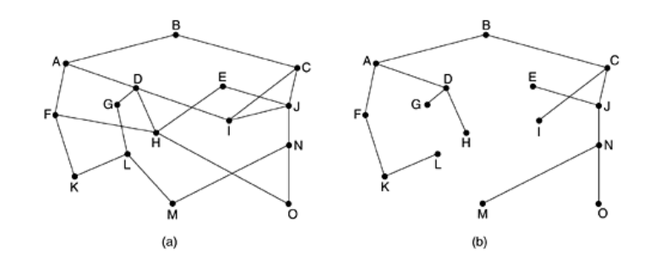
Network Layer
As a direct consequence of the optimality principle, we can see that the set of optimal routes from all sources to a given destination form a tree rooted at the destination. Such a tree is called a sink tree.

Slide 8
Network Layer
Since a sink tree is indeed a tree, it does not contain any loops, so each packet will be delivered within a finite and bounded number of hops. In practice, life is not quite this easy. Links and routers can go down and come back up during operation, so different routers may have different ideas about the current topology.

Slide 9
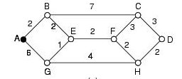
Network Layer
Dijkstras Algorithm
At the end each node will be labeled (see Figure) with its distance from source node along the best known path. Initially, no paths are known, so all nodes are labeled with infinity. As the algorithm proceeds and paths are found, the labels may change reflecting better paths. Initially, all labels are tentative. When it is discovered that a label represents the shortest possible path from the source to that node, it is made permanent and never changed thereafter.

Slide 10
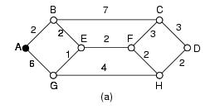
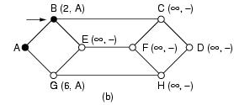
Network Layer
Look at the weighted undirected graph of Figure.1(a), where the weights represent, for example, distance. We want to find shortest path from A to D. We start by making node A as permanent, indicated by a filled in circle. Then we examine each of the nodes adjacent to A (the working node), relabeling each one with the distance to A. Whenever a node is relabeled, we also label it with the node from which the probe was made so that we can construct the final path later. Having examined each of the nodes adjacent to A, we examine all the tentatively labeled nodes in the whole graph and make the one with the smallest label permanent, as shown in Figure.1(b). This one becomes new working node.

Slide 11
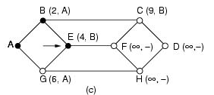
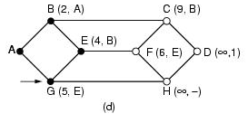
Network Layer

Slide 12
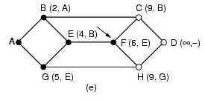
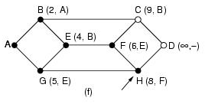
Network Layer

Slide 13
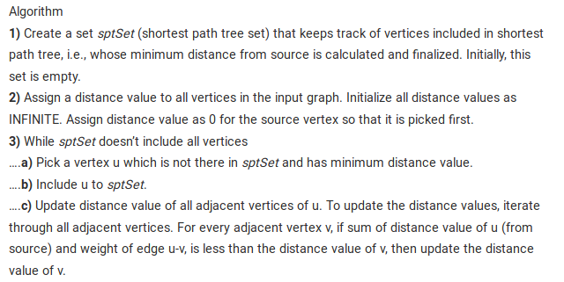
Network Layer
Dijkstras Algoritham

Slide 14
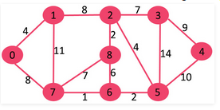
Network Layer
Consider following graph and find shortest path.

Slide 15

Network Layer
The set sptSet is initially empty and distances assigned to vertices are {0, INF, INF, INF, INF, INF, INF, INF} where INF indicates infinite. Now pick the vertex with minimum distance value. The vertex 0 is picked, include it in sptSet. So sptSet becomes {0}. After including 0 to sptSet, update distance values of its adjacent vertices.
Adjacent vertices of 0 are 1 and 7. The distance values of 1 and 7 are updated as 4 and 8. Following subgraph shows vertices and their distance values, only the vertices with finite distance values are shown. The vertices included in SPT are shown in green colour.

Slide 16
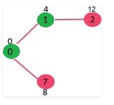
Network Layer
Pick the vertex with minimum distance value and not already included in SPT (not in sptSET). The vertex 1 is picked and added to sptSet. So sptSet now becomes {0, 1}. Update the distance values of adjacent vertices of 1. The distance value of vertex 2 becomes 12.

Slide 17
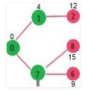
Network Layer
Pick the vertex with minimum distance value and not already included in SPT (not in sptSET). Vertex 7 is picked. So sptSet now becomes {0, 1, 7}. Update the distance values of adjacent vertices of 7. The distance value of vertex 6 and 8 becomes finite (15 and 9 respectively).

Slide 18
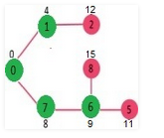
Network Layer
Pick the vertex with minimum distance value and not already included in SPT (not in sptSET). Vertex 6 is picked. So sptSet now becomes {0, 1, 7, 6}. Update the distance values of adjacent vertices of 6. The distance value of vertex 5 and 8 are updated.

Slide 19
Network Layer
Pick the vertex with minimum distance value and not already included in SPT (not in sptSET). Vertex 6 is picked. So sptSet now becomes {0, 1, 7, 6}. Update the distance values of adjacent vertices of 6. The distance value of vertex 5 and 8 are updated.

